Slide 1

Project name : Air Quality Monitoring
DEPARTMENT OF COMPUTER SCIENCE AND ENGINEETRING
Team name : Proj_22478_Team_5
Team members :
Javvaji vamsikrishna(113321104032)
Kantabathina Venkata Koushik reddy(113321104037) Katari Lokesh(113321104040) Arun Kishore P M(113321104047)

Slide 2
Problem Statement
In many urban areas, air quality is a major issue that affects people's health and wellbeing. Air quality monitoring is essential for identifying sources of pollution and for taking effective action to improve air quality. The goal of this project is to create an IoT-based solution for real-time monitoring of air quality. The system will gather data from a variety of sensors and provide an easy-to-use platform for users to view and analyze this data.

Slide 3
Objectives:
Real-time air quality monitoring: Create an Internet of Things (IoT) system that continuously monitors important air quality indicators, such as PM2.5, PM10, CO, NO2, and ozone.
Data Collection and Transmission: Configure Internet of Things devices with the necessary Real-time Air Quality Monitoring: Create an Internet of Things (IoT) system that is able to detect important air quality metrics in real-time, such as ozone (O3), carbon monoxide (CO), nitrogen dioxide (NO2), and particulate matter (PM2.5 and PM10). Configure Internet of Things (IoT) devices with the necessary sensors to gather data on air quality and send it to a central platform.
Data Visualisation: Provide an easy-to-use platform for exchanging data, allowing users to access historical data and current air quality statistics via an intuitive user interface. : Provide an easy-to-use platform for exchanging data, allowing users to access historical data and current air quality statistics via an intuitive user interface
Alerting and Reporting: Put in place an alerting system that sends out notifications to users when metrics related to air quality surpass predetermined limits. Make reports as well for the examination of past data. sensors to gather information about air quality and send it to a central hub. Put in place an alerting system that sends out notifications to users when metrics related to air quality surpass predetermined limits. Make reports as well for the examination of past data.

Slide 4
IoT Device Setup
For the IoT device setup, we will use the following components and sensors:
Microcontroller: Raspberry Pi or Arduino for data processing and communication.
Air Quality Sensors: Sensors capable of measuring PM2.5, PM10, CO, NO2, and O3 levels.
Data Transmission: Wi-Fi or GSM module to send data to the central platform.
Power Supply: Battery or an external power source depending on the deployment location

Slide 5
Platform Development
Database Setup: Create a database to store the incoming air quality data.
Web Application: Develop a web-based application that allows users to access and visualize the data. The platform should have user registration, login, and data representation features.
Threshold Configuration: Implement a feature that enables users to set alert thresholds for each air quality parameter.
Real-time Updates: Ensure that the platform receives and updates data in real-time.

Slide 6
Code
import random
# Function to generate random sensor data
def generate_sensor_data():
pm25 = random.uniform(0, 100)
co = random.uniform(0, 5)
no2 = random.uniform(0, 1)
o3 = random.uniform(0, 0.1)
return pm25, co, no2, o3
# Function to calculate the Air Quality Index (AQI)
def calculate_aqi(pm25, co, no2, o3):
# Replace with your AQI calculation logic
# This is a simplified example; use an appropriate formula for AQI calculation
aqi = (pm25 + co + no2 + o3) / 4
return aqi

Slide 7
Code
# Function to classify air quality based on AQI
def classify_air_quality(aqi):
if aqi <= 50:
return "Good"
elif aqi <= 100:
return "Moderate"
elif aqi <= 150:
return "Unhealthy for Sensitive Groups"
elif aqi <= 200:
return "Unhealthy"
else:
return "Very Unhealthy"

Slide 8
Code
# Generate sensor data
pm25, co, no2, o3 = generate_sensor_data()
# Calculate AQI
aqi = calculate_aqi(pm25, co, no2, o3)
# Classify air quality
air_quality = classify_air_quality(aqi)
# Output the results
print(f"PM2.5: {pm25} µg/m³")
print(f"CO: {co} ppm")
print(f"NO2: {no2} ppm")
print(f"O3: {o3} ppm")
print(f"AQI: {aqi}")
print(f"Air Quality: {air_quality}")

Slide 9
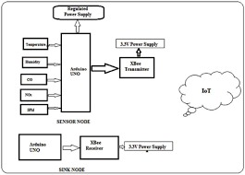
BLOCK DIAGRAM

Slide 10
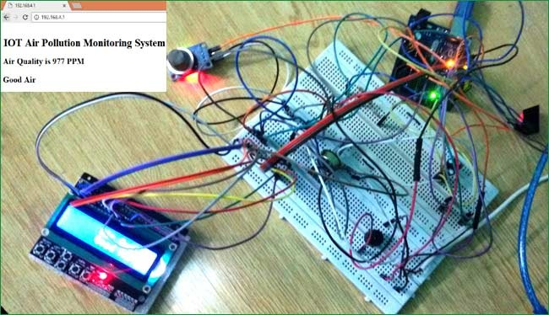
Screenshots of the IoT devices

Slide 11
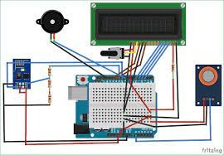

Slide 12
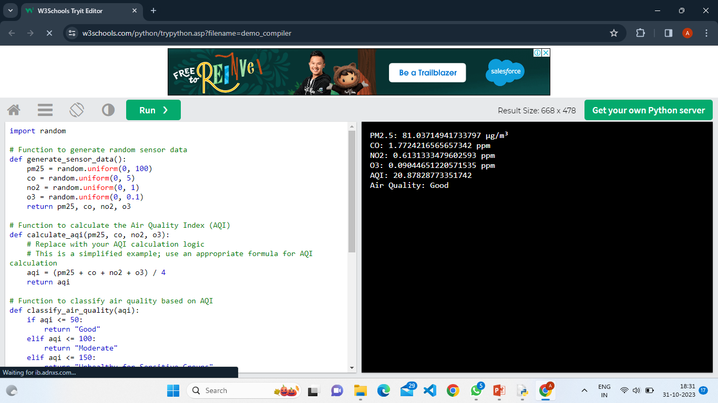
SCREENSHOT OF PYTHON CODE OUTPUT

Slide 13
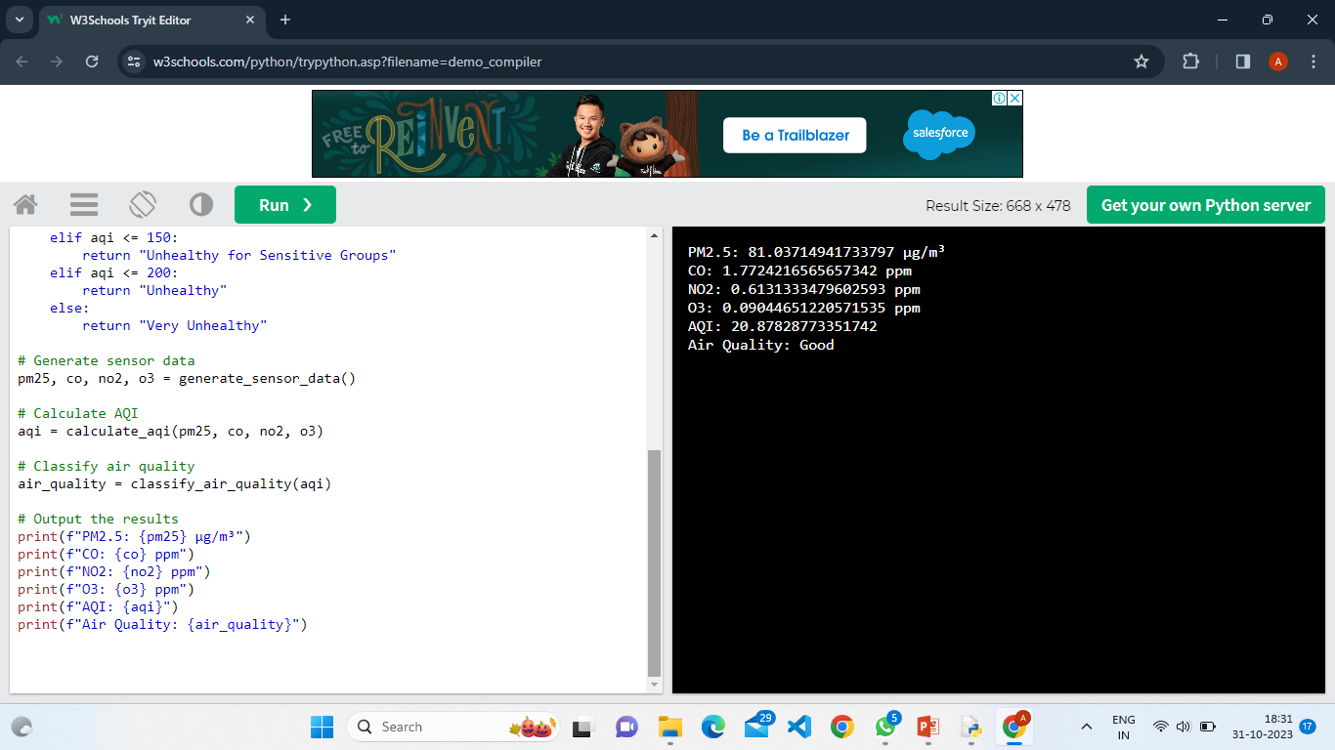

Slide 14
IoT Device Code
Initialize and configure sensors.
Set up data transmission protocols (e.g., MQTT or HTTP).
Implement error handling and retry mechanisms for data transmission.
Continuously collect and send data to the central platform.

Slide 15
Data Sharing Platform UI
The platform's user interface should include the following components:
User Registration and Login: Secure user authentication for data access.
Dashboard: A user-friendly dashboard displaying real-time air quality data.
Historical Data Visualization: Charts and graphs for historical data analysis.
Alert Configuration: A settings page to set and manage alert thresholds.
Notifications: Real-time alerts and notifications when air quality parameters exceed thresholds.

Slide 16
EXPLANATION
Monitoring air quality is crucial for protecting the environment and public health, particularly in cities where air pollution is a problem. An Internet of Things (IoT)-based air quality monitoring system is presented in this project. It is intended to continually gather data from IoT devices that have sensors measuring important air quality indicators, such as PM2.5, CO, NO2, and O3. The main goals of the project are to classify air quality situations, compute an Air Quality Index (AQI), and transfer this data to a central platform. A user-friendly platform allows users to access this data, establish alarm levels, and get messages when the quality of the air declines. By enabling people and communities to make educated decisions about their well-being and the influence they have on the environment, this technology helps to raise awareness of environmental issues in real time.

Slide 17
CONCLUSION
For environmental and public health monitoring, the creation of an Internet of Things air quality monitoring system is essential. This project seeks to give people and authorities an easy-to-use platform to get real-time data on air quality by merging web technologies with air quality sensors. The platform will help people make more educated decisions about environmental management and raise awareness of issues related to air quality. It is anticipated that this project's successful conclusion would enhance air quality management and monitoring in several areas.

Slide 18
THANK YOU

